Slide 1
Core for athletes

Slide 2


Slide 3
Static core:
Plank /forearm plank
Side plank /drop knee
Reverse talbe/reverse plank
Boat/legs bent

Slide 4
Leg warm-up
Bodyweight squat x 8
Squat hold x 10s
Standing quad stretch
Repeat Left
Holy fig x 5 cnt
Standing toe balance x 5 cnt
Lateral side squats x 4 (2 right /2 left)

Slide 5
Lunge series
Low lunge
Balancing lunge (chest upright; hands on thigh)
Crescent lunge
Lunge with quad stretch (or remain in lunge)
Revolved front lunge
Crocodile
Runners lunge, toes down
Runners lunge, toes up

Slide 6
Dynamic core:
Staff inhale raise legs over hips inhale
Roll down to back exhale lower legs to floor exhale
Lift legs over hips inhale roll up to staff inhale
Plow exhale seated forward fold exhale
Raise legs over hips inhale inhale to staff
Lower legs to floor exhale roll down to mat
Roll up to staff inhale reclining twist right center left
Seated forward fold exhale inhale to bridge
                Leg lift right (perpendicular) leg lift straight (parallel)

Slide 7
Roll-ups (slow)
Single straight leg
Double leg stretch
Boat twist
Drop feet to mountain top abs
Updog
Updog twist
Crunch---knee crunch----toe reach---kickout
Roll-ups (slow) x 60 s

Slide 8
Table core:
Working both sides before moving on to next movement.
Crossbow
Modified side plank
Half moon balance on knee
Side bow
birddog
Child’s pose

Slide 9
Banded core
CRUNCH
ROLL-UP
SINGLE LEG ROLL-UP (1 LEG FLEXED AT KNEE; HEEL ON MAT)
UPDOG TWIST
THREAD NEEDLE R & L

Slide 10
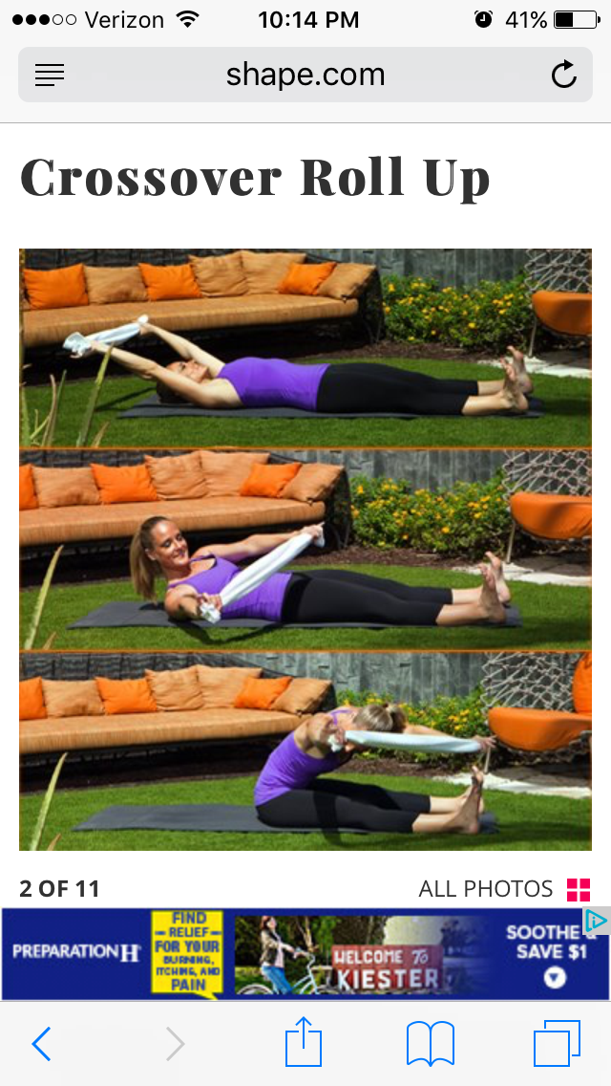

Slide 11
SINGLE STRAIGHT LEG
PILATES 100
LOCUST
CHILD’S POSE

Slide 12
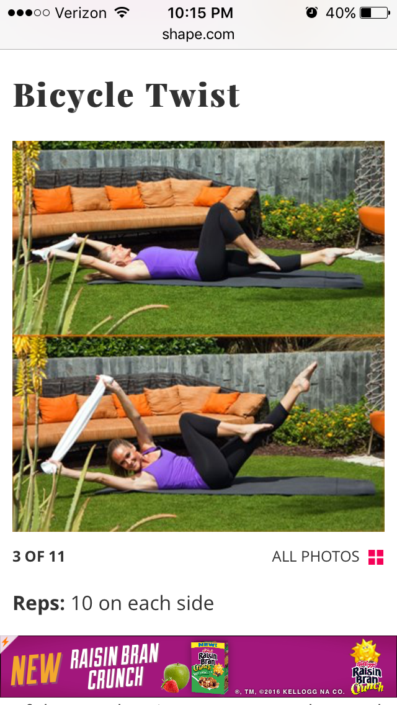

Slide 13
SUPERMAN
BANANA
BOAT
LOW BOAT
BALL/BRIDGE

Slide 14
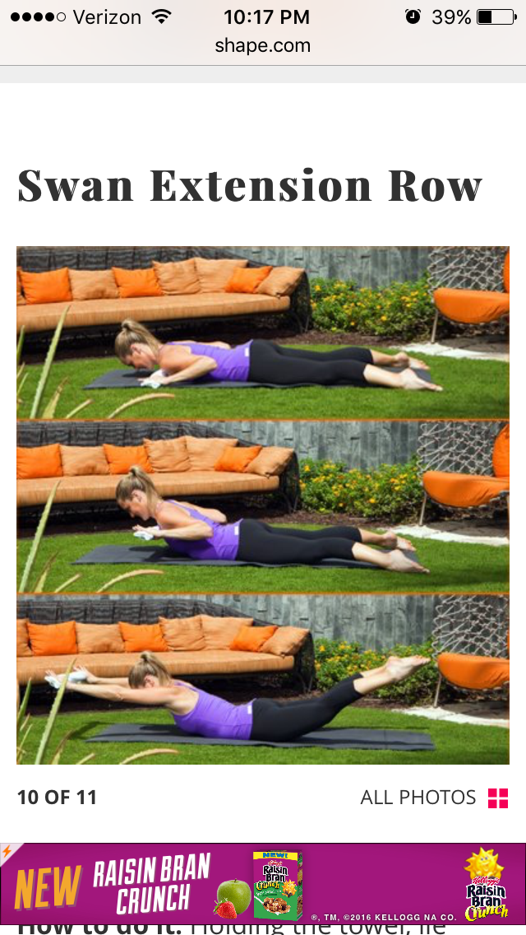

Slide 15
OPPOSITE ARM/LEG FLUTTERS
BOXES
CHILD’S POSE

Slide 16
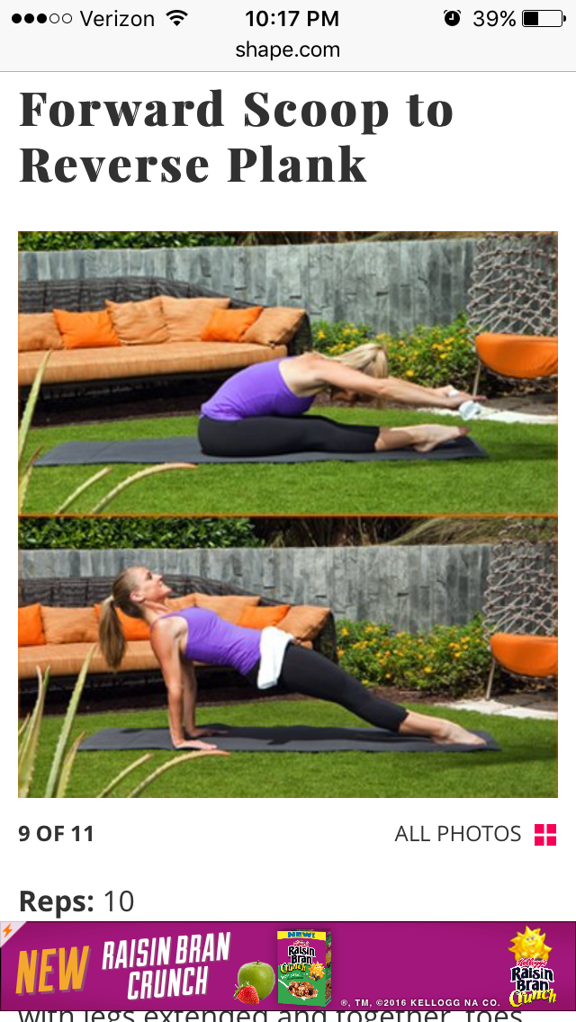

Slide 17
WALKING PLANKS R-M-L
UPDOG
LOW CRESCENT POWER POSE (ARMS STRAIGHT NEXT TO EARS)—HANDS ON MAT—SWITCH FEET--- LOW CRESCENT POWER POSE----UPDOG TWIST

Slide 18
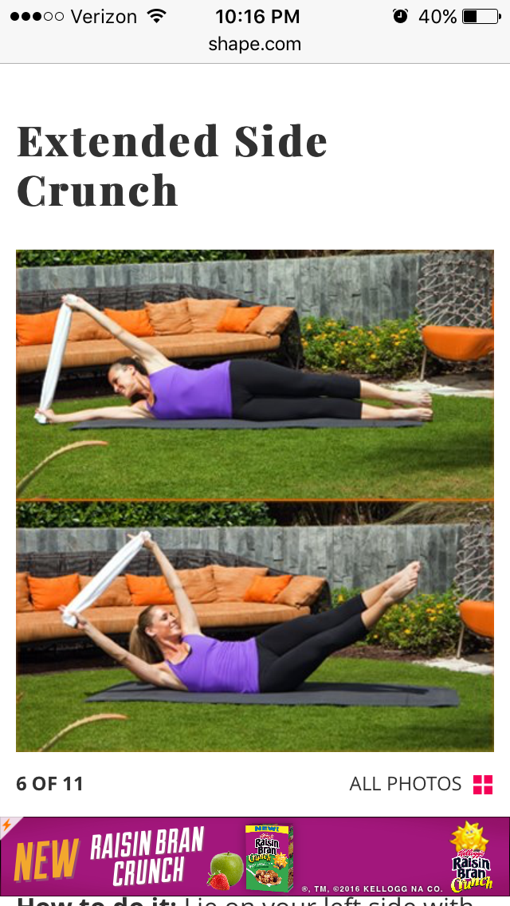

Slide 19
FRONT PLANK KNEE DRIVE HOLD R/L -----PLANK JACK X 4
CHILD’S POSE

Slide 20
